Slide 1

Food Insecurity In America
Nancy Carlson
Denise E. Harris
Breanna Hernandez
Aidan Nelson

Slide 2

Table of Contents
Introduction
Project Overview
Analysis of 8 group populations using Geo plots
Thank you
Appendix – Plot comparison by County

Slide 3

Introduction Observe Food Insecurity Patterns using Geo Plots
Locate food insecurities by the following populations:
Low-income, Elderly, Children and 5 Race groups.
Within these four cities:
Columbus Ohio (Franklin County)
Lafayette Indiana (Tippecanoe County)
Charlotte West Virginia (Kanawha County)
Chicago Illinois (Cook County)
Check correlation intensity of our data:
Linear Regression Model

Slide 4

Project Overview
Sources:
Food Atlas 2019:
https://www.ers.usda.gov/data-products/food-access-research-atlas/download-the-data/
Census Shape files:
https://www.census.gov/cgi-bin/geo/shapefiles/index.php?year=2010&layergroup=Census+Tracts
Variable Definitions:
Food Insecurity is defined by the variable:
LALOWI1_10: Low-income population count beyond 1 mile for urban areas or 10 miles for rural areas from supermarket.
All population groups are defined by a variable using the same
Constraint, "Low Access" defined by:
lakids1: Kids population count beyond 1 mile from supermarket.
Low-income is defined by Median Family Income <= $80,000
MedianFamilyIncome: Tract median family income

Slide 5

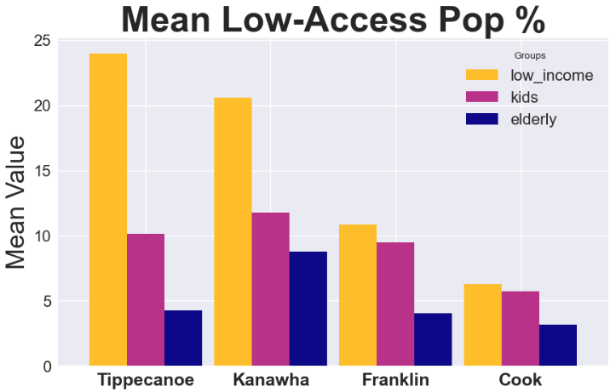
Income
The low-income population percentage is much higher compared to the children and elderly populations yet the intensity of correlation on food insecurity levels was much lower.
In all counties as income decreases food insecurity increases.
In contrast to other groups, highest low-income populations with food insecurities are located in higher populated tracts.

Slide 6
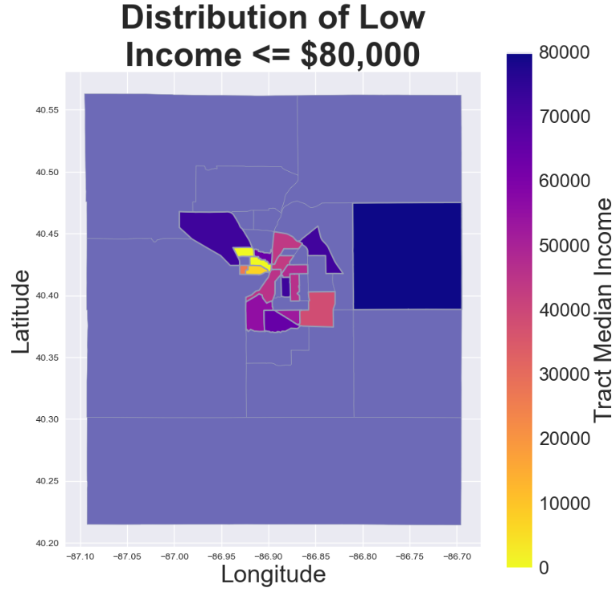
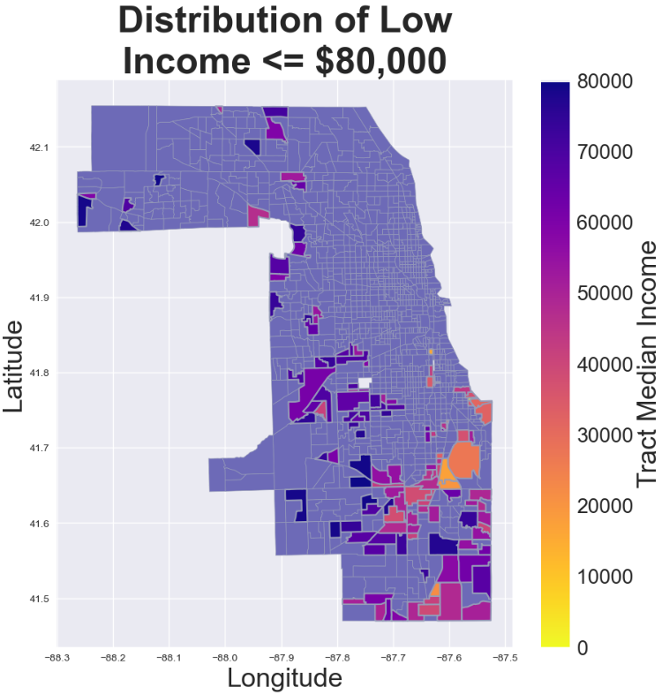
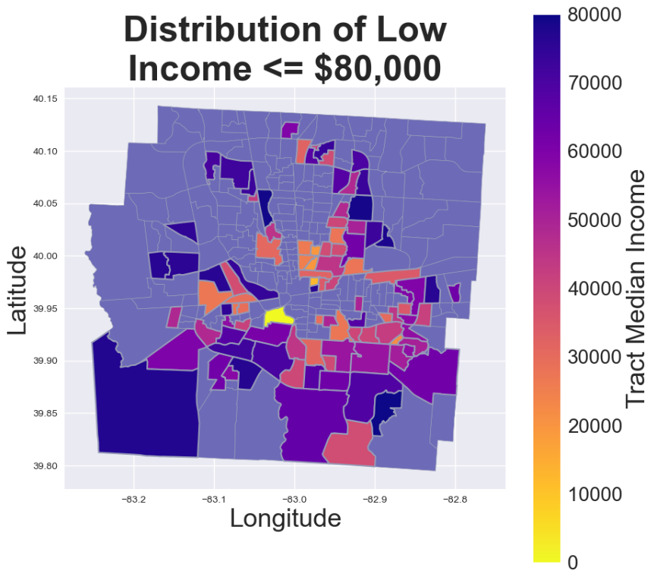
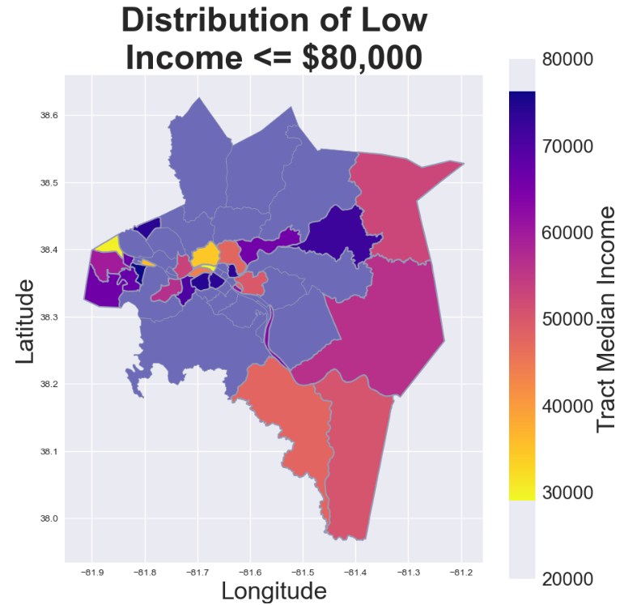
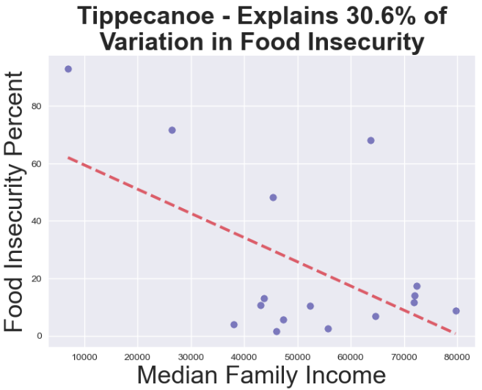
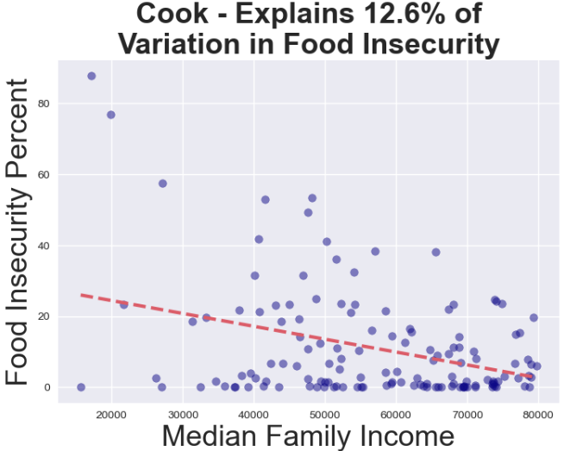
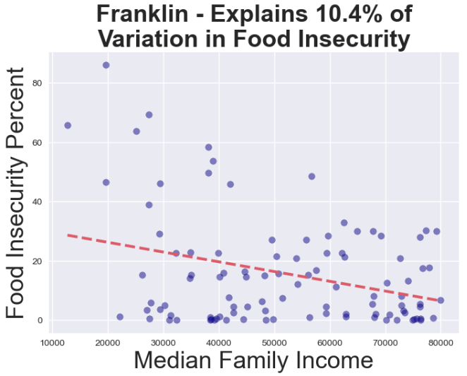
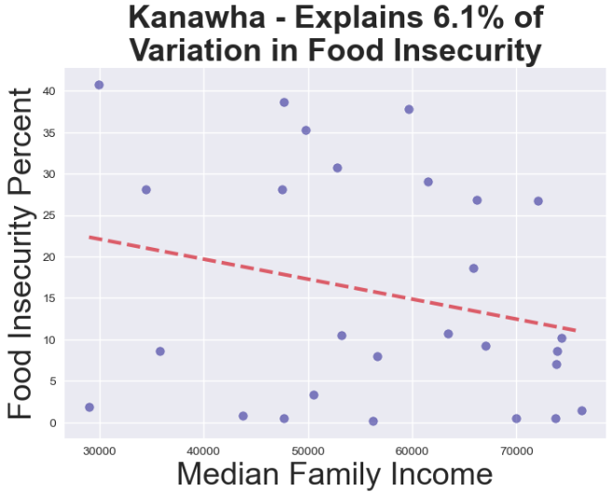
Food Insecurity Tracts by Income level

Slide 7

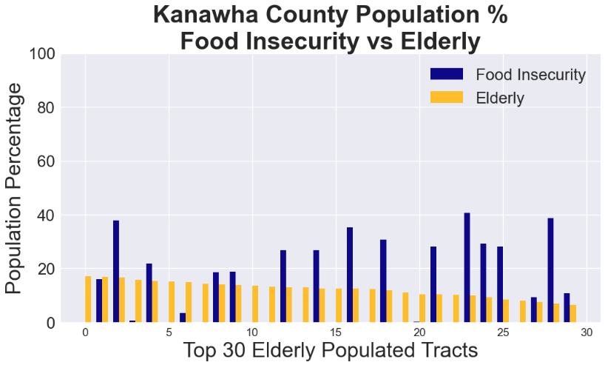
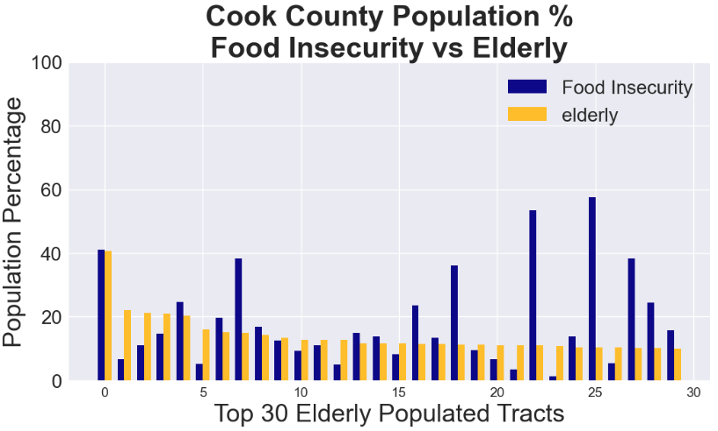
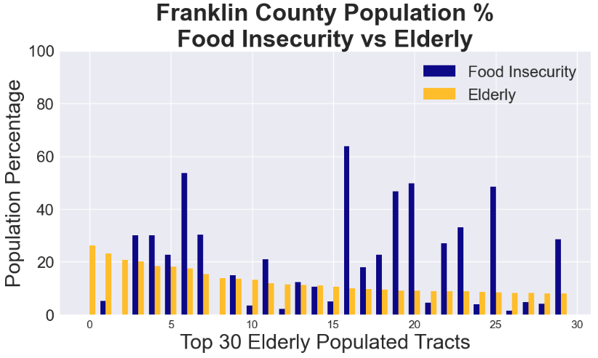
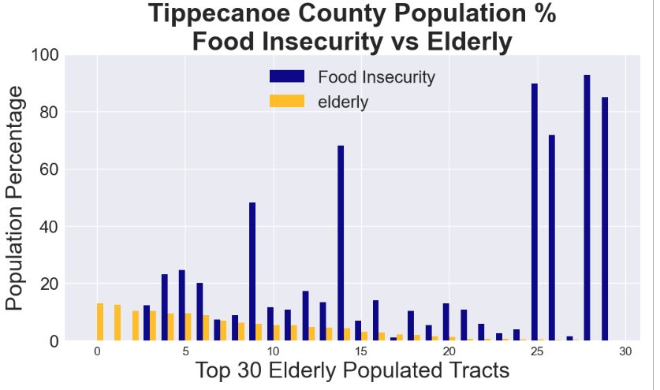
Elderly 65+
g
The elderly is not the most food insecure group.
Consider subgroups within the elderly population to find food insecurity.
This group does not have a food insecurity in Tippecanoe County.
Tracts situated around the edges of the county away from highly populated city tracts.

Slide 8
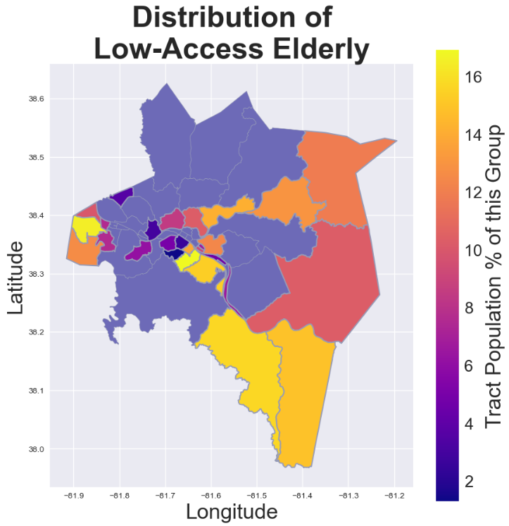
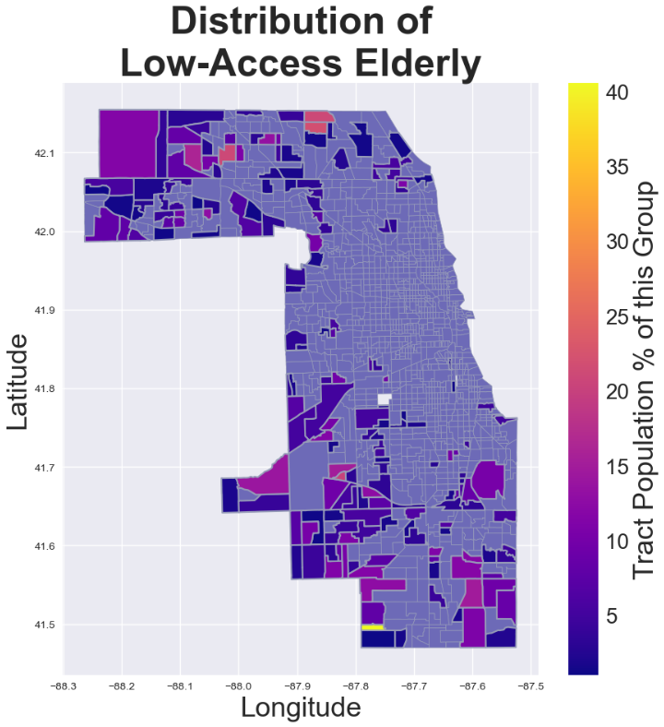
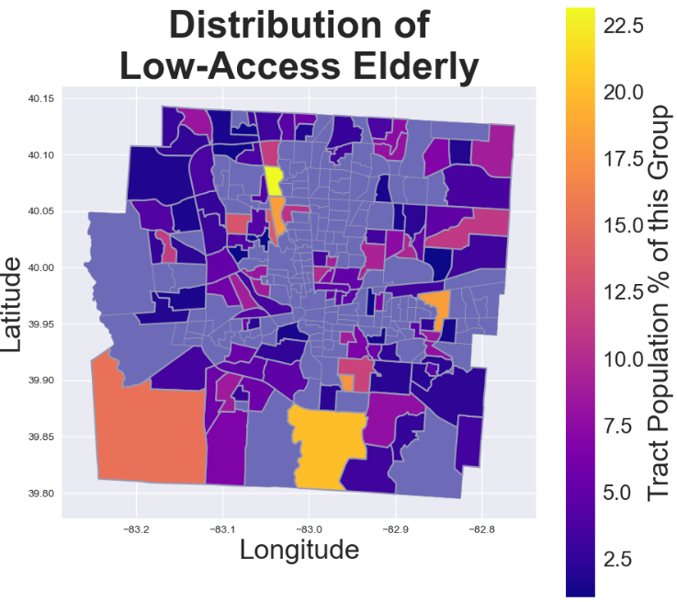
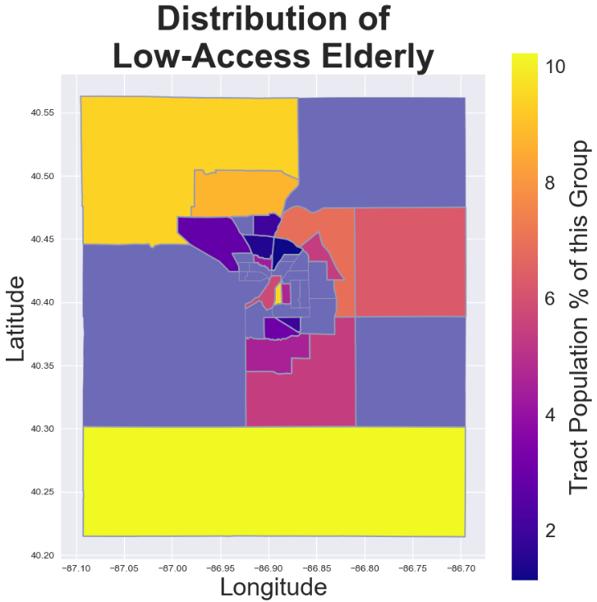
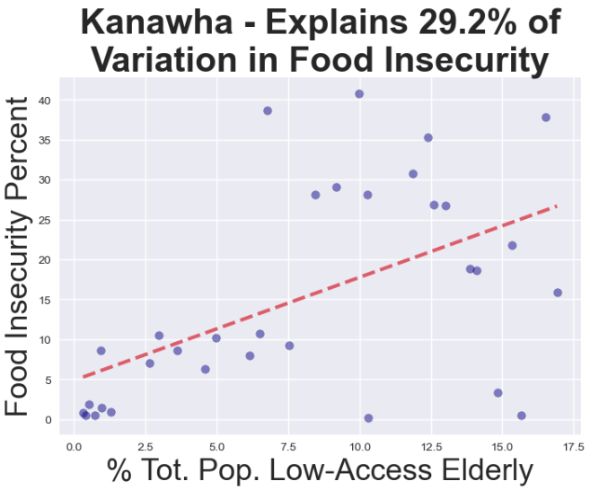
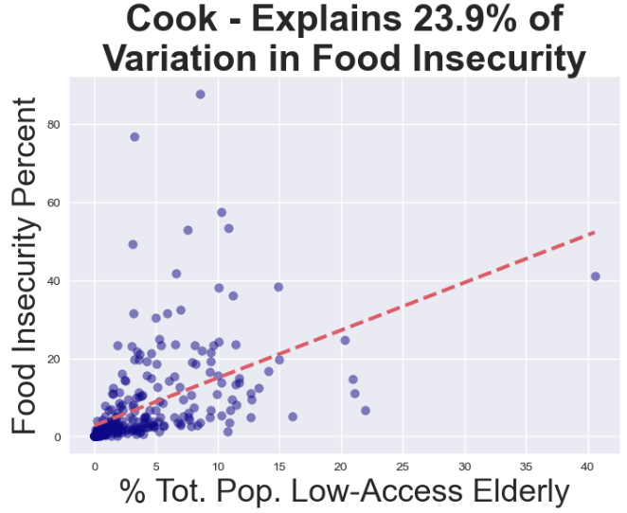
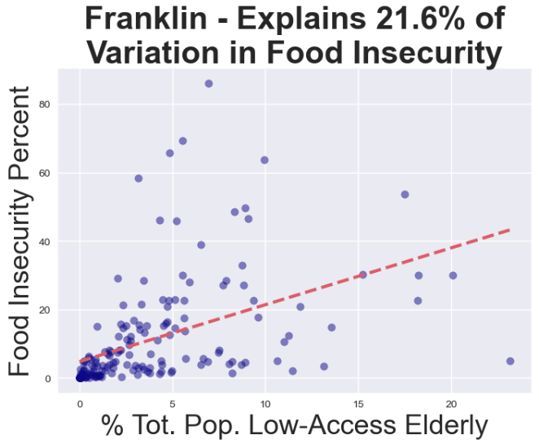
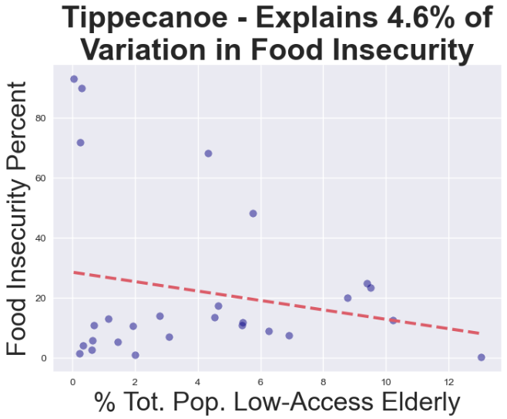
Food Insecurity Tracts by Low-Access Elderly

Slide 9

Interactive Visualization
https://ephemeral-donut-fb40ee.netlify.app/

Slide 10

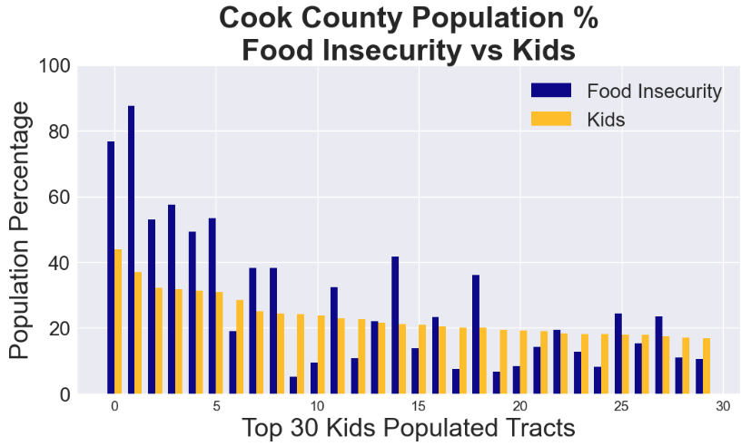
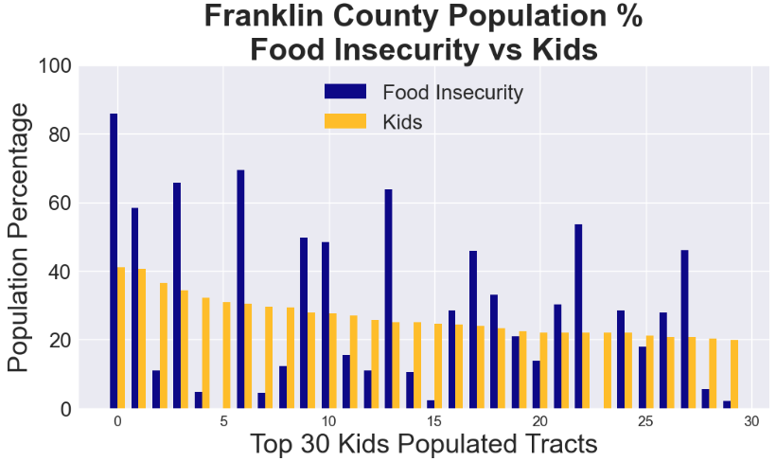
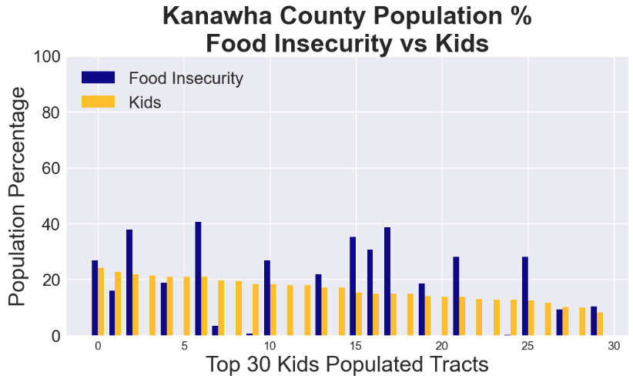
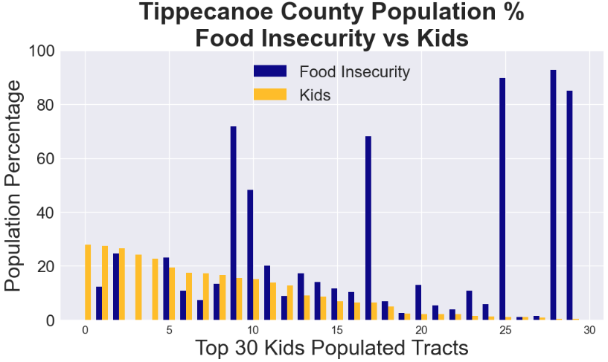
Kids
Cook County has the highest food insecurity intensity correlation to kids with low-access, of all the counties.
The relationship between food insecurity and low-access kids for Tippecanoe County is inconclusive.
The food insecurity tracts on these maps are similar to the tracts of the elderly.

Slide 11
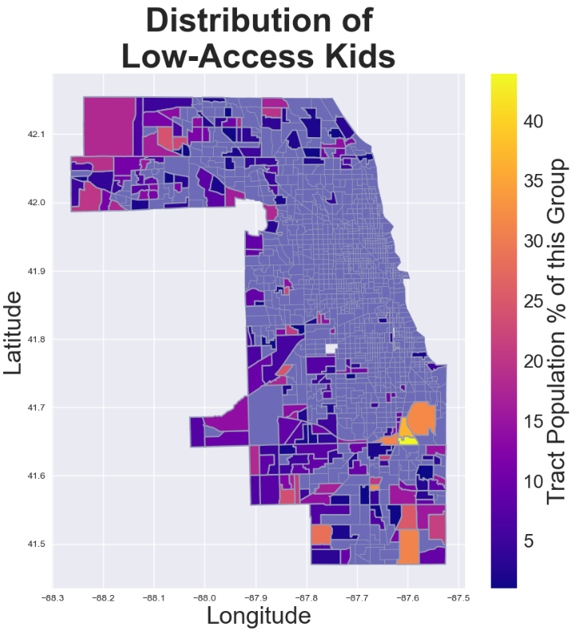
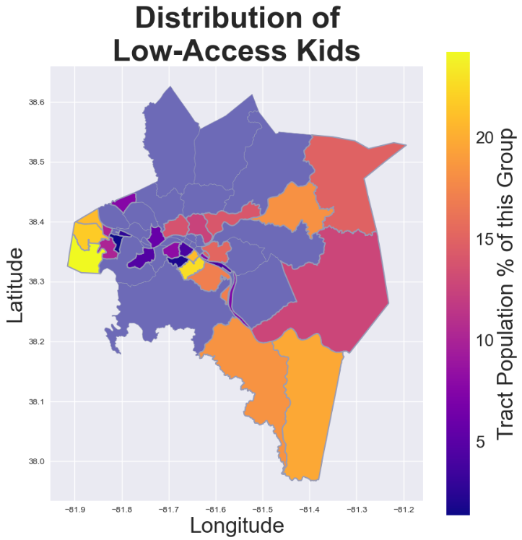
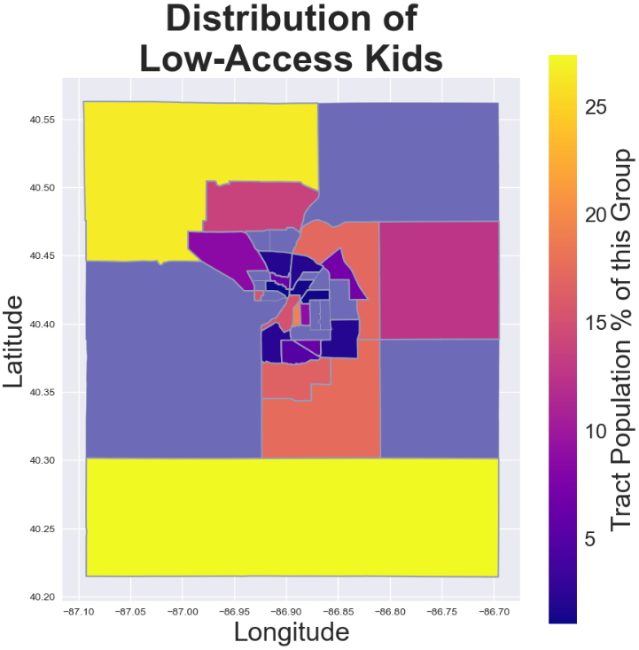
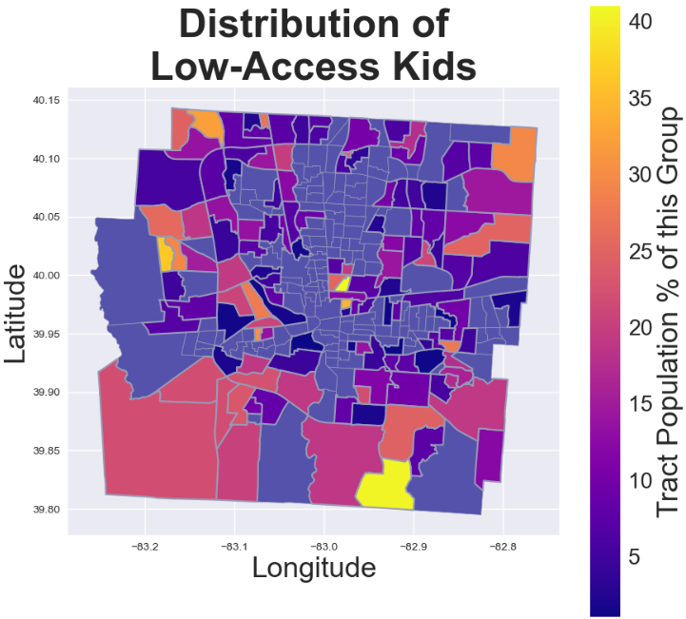
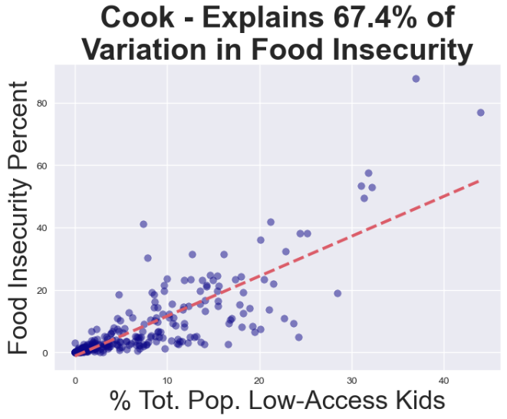
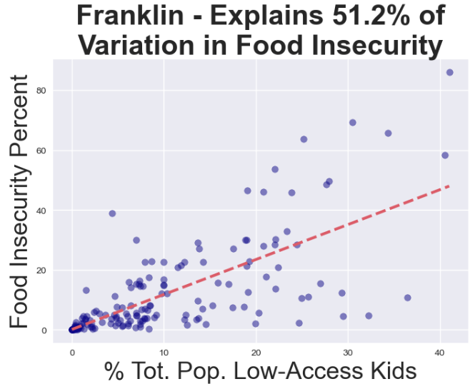
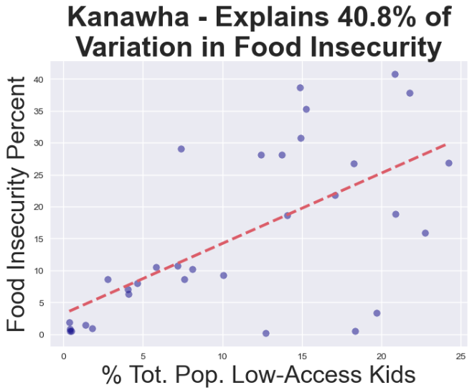
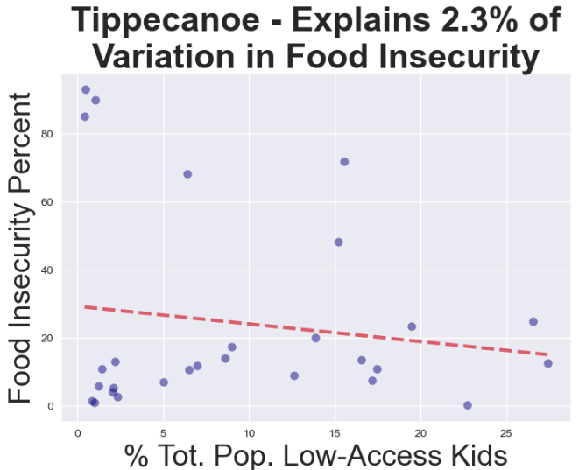
Food Insecurity Tracts by Low-Access Kids

Slide 12
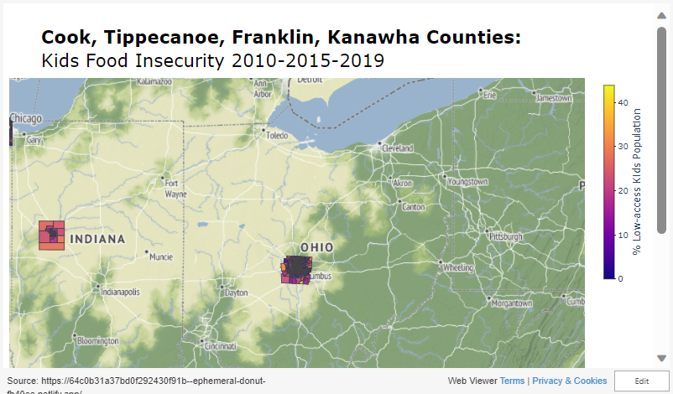
Interactive Visualization

Slide 13

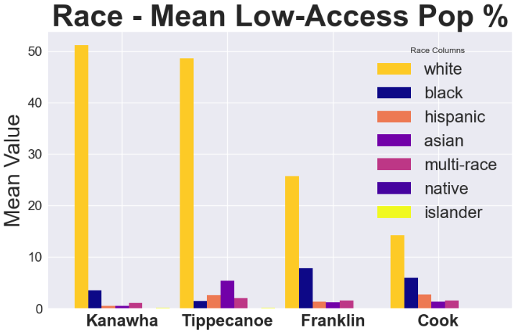
Ethnicity/Race
All counties are predominately populated with people who are in the White race group.
Black, Multi-Race, and Hispanic Races have the highest significant food insecurity levels across 3 counties.
White and Asian Races have the least food insecurities.
Asian Race has the highest food insecurity in Tippecanoe county.
A higher quantity of a Race population does NOT correlate with an increase in food insecurity.
Races with high significant food insecurities are clustered together, usually in high populated tracts.

Slide 14
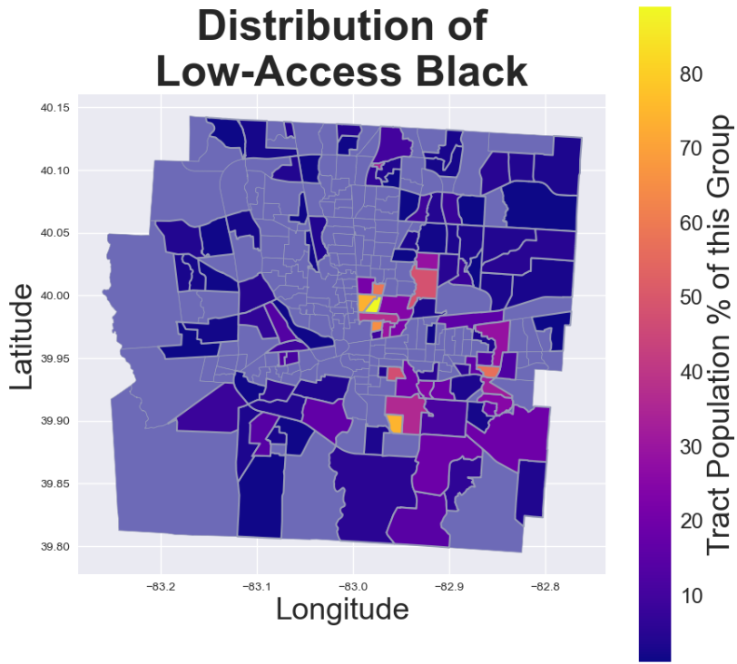
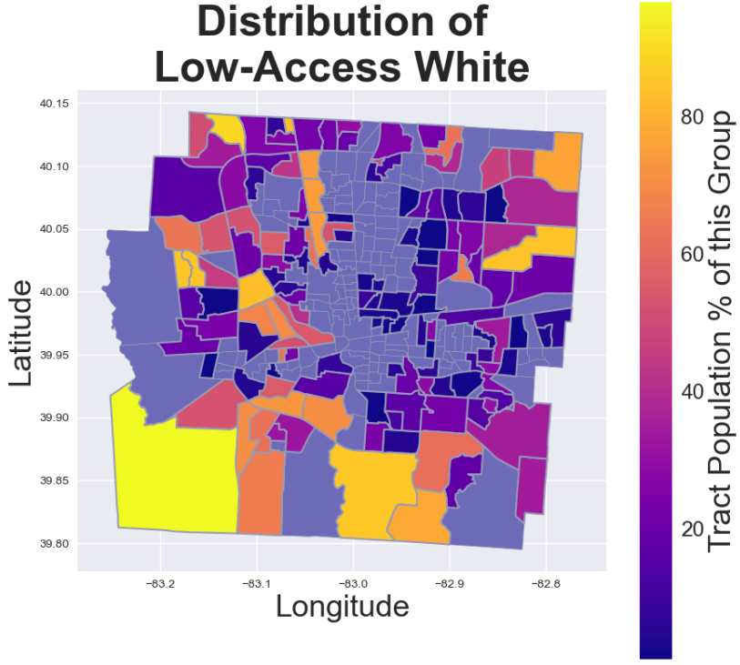
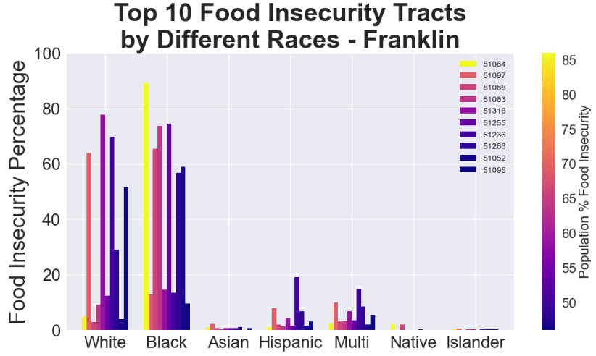
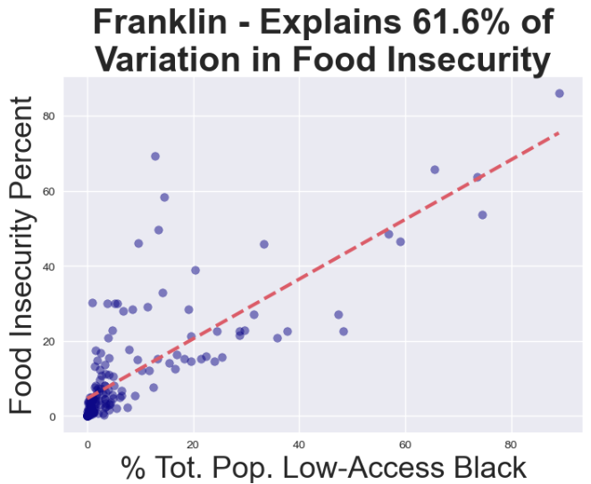
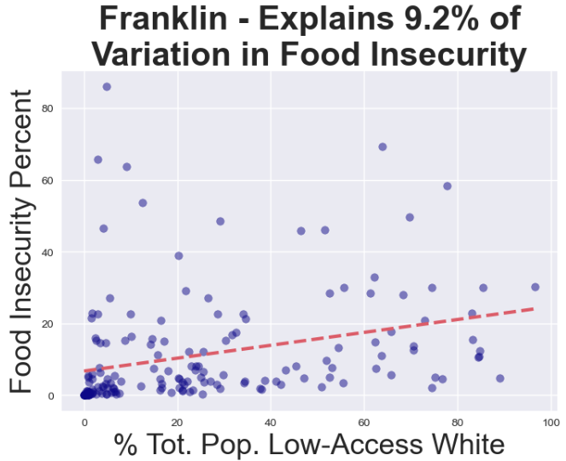
Food Insecurity by Race: Franklin County

Slide 15
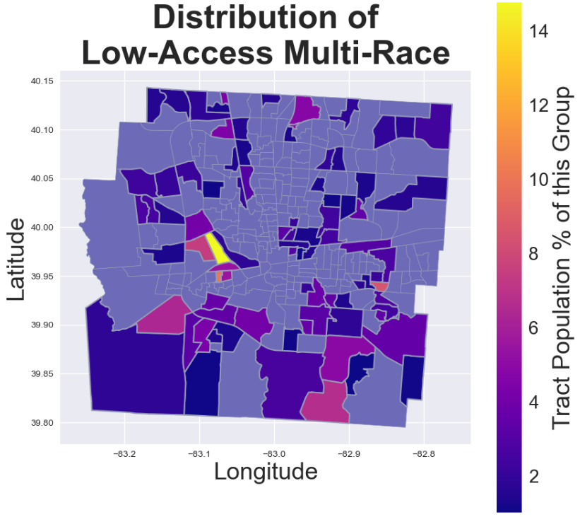
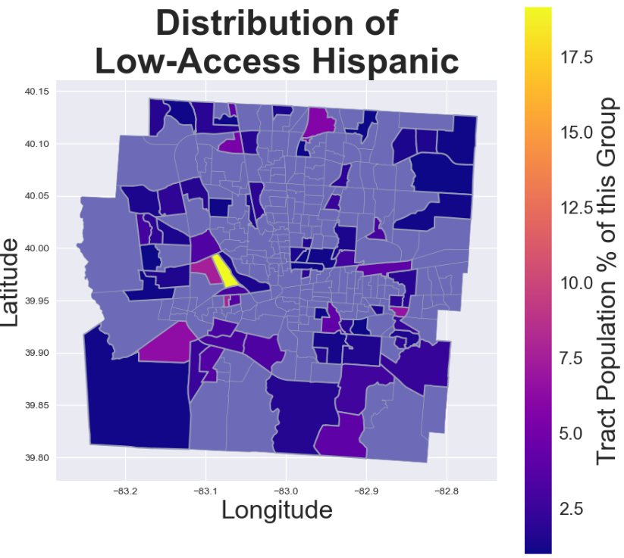
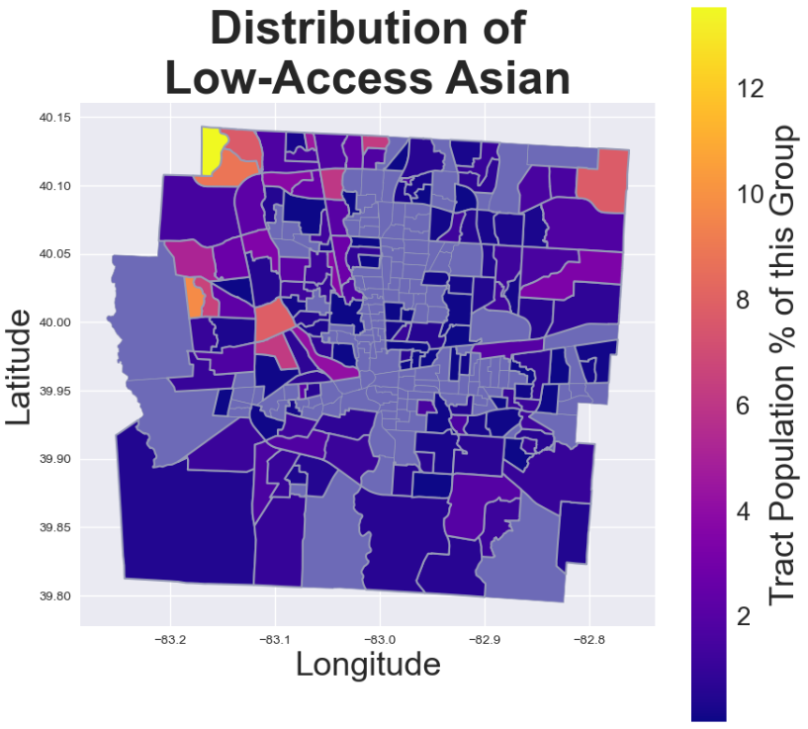
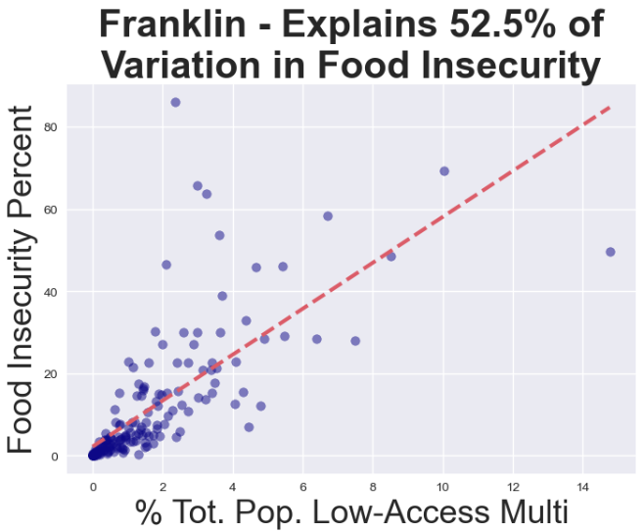
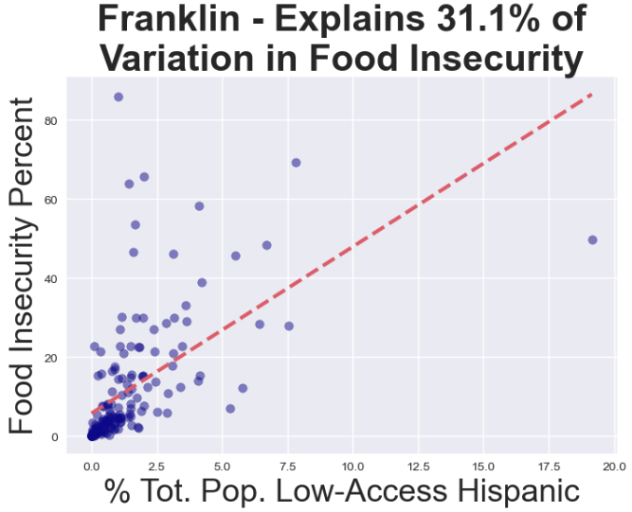
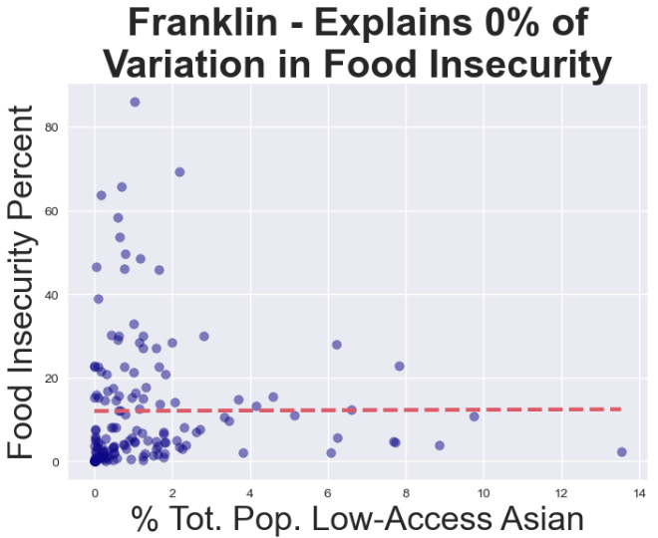
Food Insecurity by Race: Franklin County

Slide 16
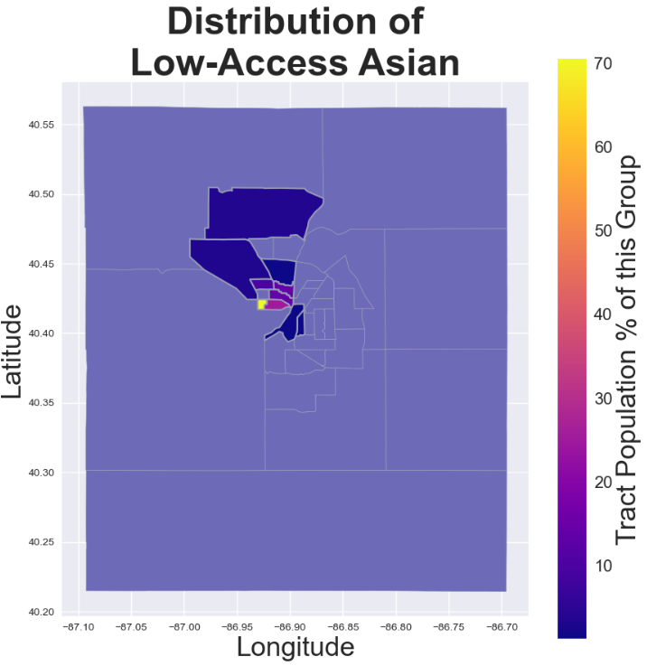
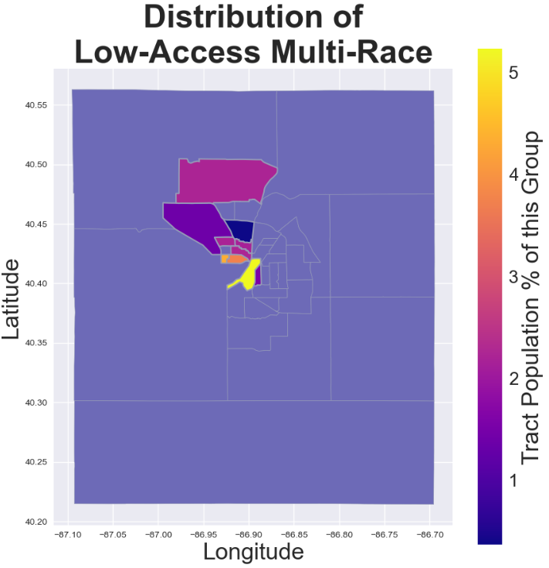
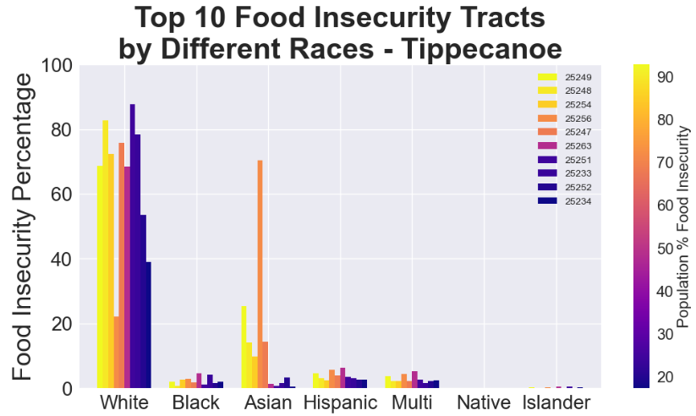
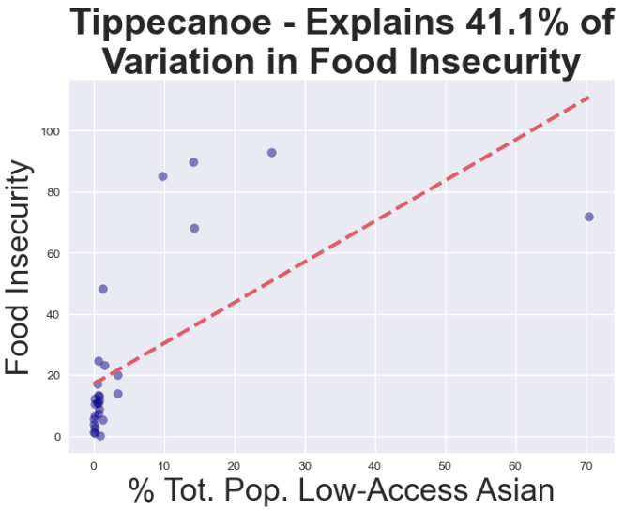



Food Insecurity by Race: Tippecanoe County

Slide 17







Food Insecurity by Race: Kanawha County

Slide 18







Food Insecurity by Race: Cook County

Slide 19





Conclusion: Overall Observations
As the percent of low-access, low-income population increase, findings show across most groups an increase in food insecurity develops.
Food insecurities are more prevalent in counties with a higher number of tracts.
Groups with food insecurities are usually located just outside of the most densely populated tracts.
Asians held the lowest food insecurities of all groups across all counties except Tippecanoe county where they are the highest at 41% significance. **

Slide 20
Conclusion: Overall Observations
Unusual findings: Tippecanoe County showed a decrease in food insecurity for the children and elderly groups.**
Higher population volume within a group, does not correlate with an increase in food insecurity.
Minority groups with low-access and low-income status holding under 10% of a tract's population showed some of the highest significance levels of food insecurities.
** Tippecanoe County food insecurity data could be skewed due to population count is largely influenced by the presence of Purdue University.

Slide 21

Next steps
Investigate other socioeconomic causes to food insecurity:
Quality of food sources in a tract.
Quality of education in a tract.
Available food resources in a tract.
Quality of job opportunities
Investigate the cause of higher levels of food insecurities in some groups. (what gaps need to be filled)
Investigate the cause of low levels of food insecurities in some groups. (what causes food security)

Slide 22
Thank you
Nationwide Insurance Corporate Partner
EAO Project Team:
EAO Leader and Program Coordinator: Josh Mills
Project Coordinators: Nick LeClaire, Dan Cisneros
The Data Mine: Purdue University
TA: Samrawit Lisanework
TDM: David Glass
DEAFPODS: Kali Lacy

Slide 23
Appendix
Geo Plots Comparison by County
Franklin
Tippecanoe
Kanawha
Cook

Slide 24



Food Insecurity: Franklin County

Slide 25



Food Insecurity: Tippecanoe County

Slide 26



Food Insecurity: Kanawha County

Slide 27



Food Insecurity: Cook County

Slide 28
Questions?
Food
Insecurity In America

